Slide 1

Notes:
Source: Oxford International Lower Secondary Computing Student Book 8, Unit 2, section 2.3 What is e-learning, printed pages 42–45, and section 2.4 Starting your e-learning project, printed pages 46–49. Classroom adaptation of approved content. Generated visuals are illustrative examples. Presentation software controls may vary by version.

Slide 2
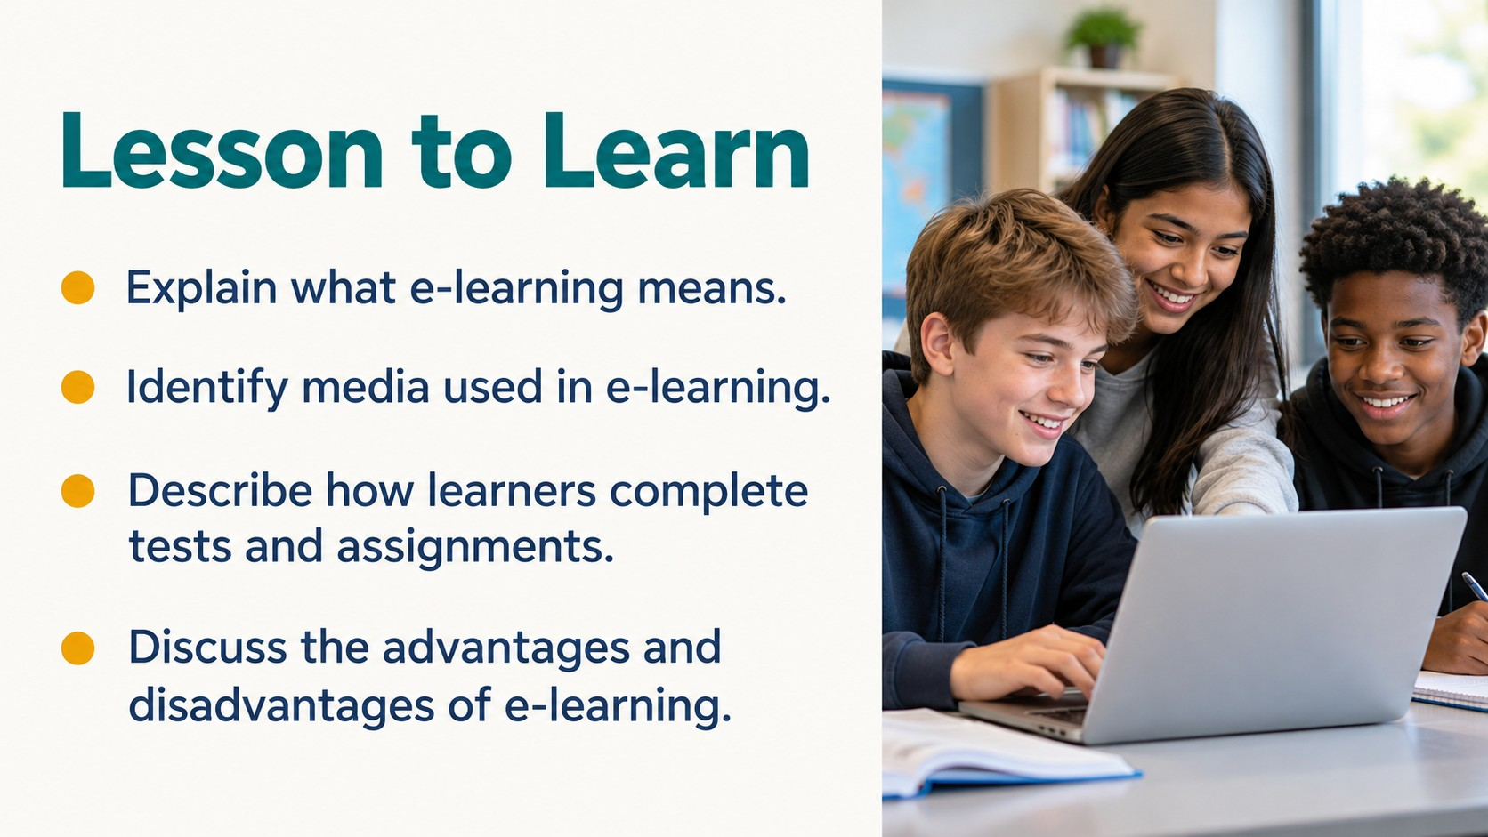
Notes:
Source: Oxford International Lower Secondary Computing Student Book 8, Unit 2, section 2.3 What is e-learning, printed pages 42–45, and section 2.4 Starting your e-learning project, printed pages 46–49. Classroom adaptation of approved content. Generated visuals are illustrative examples. Presentation software controls may vary by version.

Slide 3
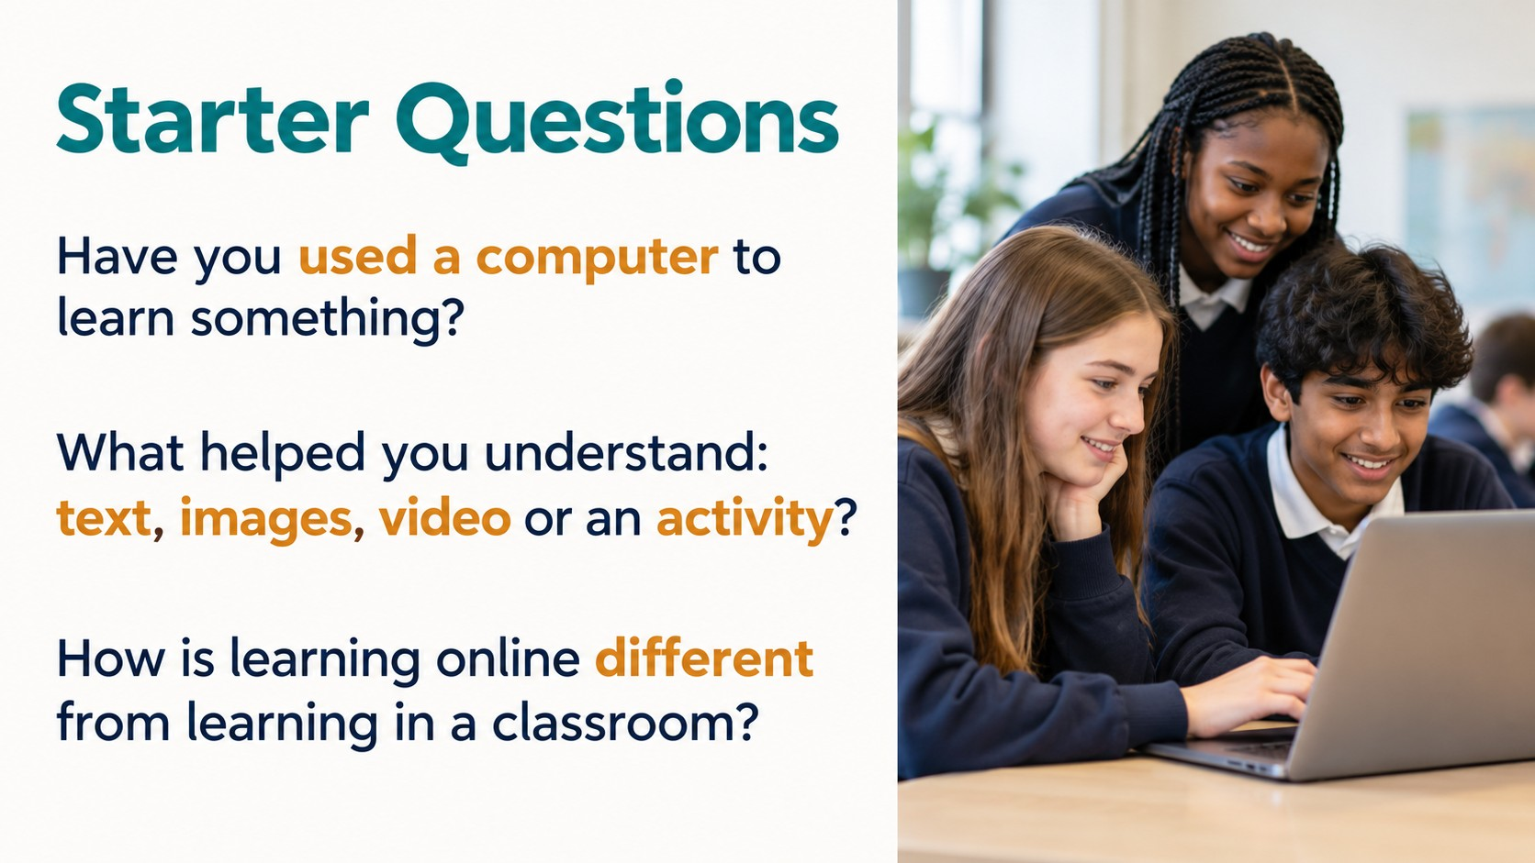
Notes:
Source: Oxford International Lower Secondary Computing Student Book 8, Unit 2, section 2.3 What is e-learning, printed pages 42–45, and section 2.4 Starting your e-learning project, printed pages 46–49. Classroom adaptation of approved content. Generated visuals are illustrative examples. Presentation software controls may vary by version.

Slide 4

Notes:
Source: Oxford International Lower Secondary Computing Student Book 8, Unit 2, section 2.3 What is e-learning, printed pages 42–45, and section 2.4 Starting your e-learning project, printed pages 46–49. Classroom adaptation of approved content. Generated visuals are illustrative examples. Presentation software controls may vary by version.

Slide 5

Notes:
Source: Oxford International Lower Secondary Computing Student Book 8, Unit 2, section 2.3 What is e-learning, printed pages 42–45, and section 2.4 Starting your e-learning project, printed pages 46–49. Classroom adaptation of approved content. Generated visuals are illustrative examples. Presentation software controls may vary by version.

Slide 6

Notes:
Source: Oxford International Lower Secondary Computing Student Book 8, Unit 2, section 2.3 What is e-learning, printed pages 42–45, and section 2.4 Starting your e-learning project, printed pages 46–49. Classroom adaptation of approved content. Generated visuals are illustrative examples. Presentation software controls may vary by version.

Slide 7
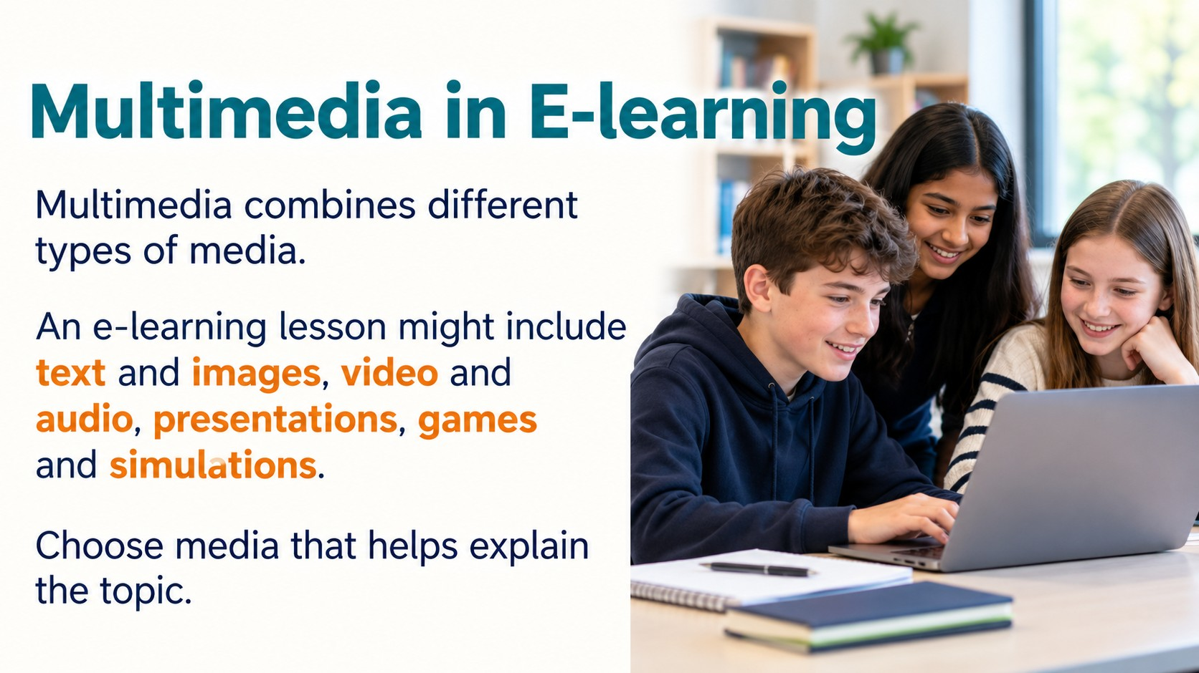
Notes:
Source: Oxford International Lower Secondary Computing Student Book 8, Unit 2, section 2.3 What is e-learning, printed pages 42–45, and section 2.4 Starting your e-learning project, printed pages 46–49. Classroom adaptation of approved content. Generated visuals are illustrative examples. Presentation software controls may vary by version.

Slide 8
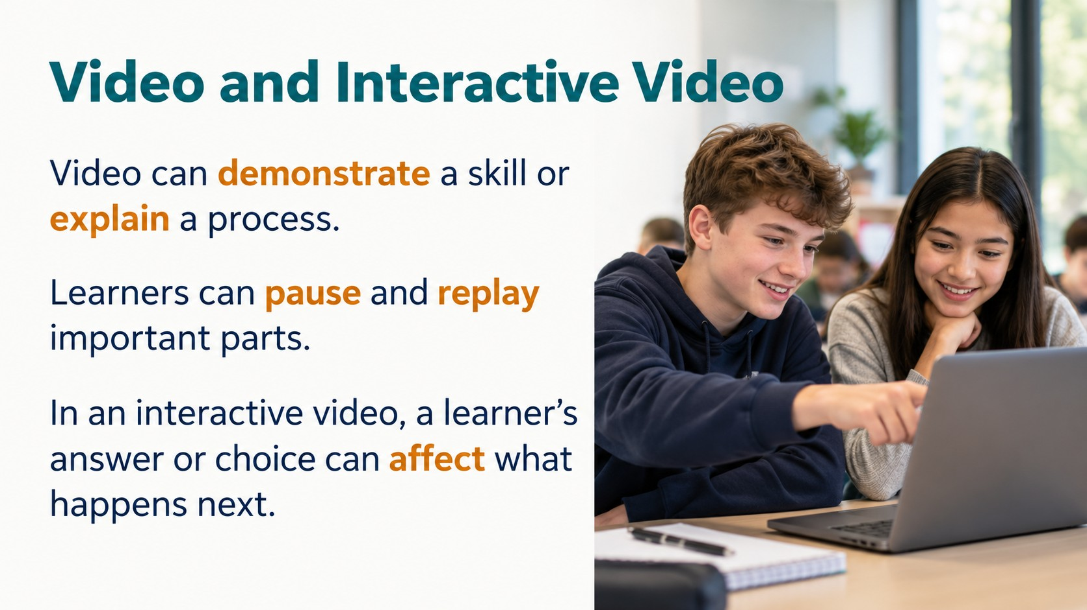
Notes:
Source: Oxford International Lower Secondary Computing Student Book 8, Unit 2, section 2.3 What is e-learning, printed pages 42–45, and section 2.4 Starting your e-learning project, printed pages 46–49. Classroom adaptation of approved content. Generated visuals are illustrative examples. Presentation software controls may vary by version.

Slide 9
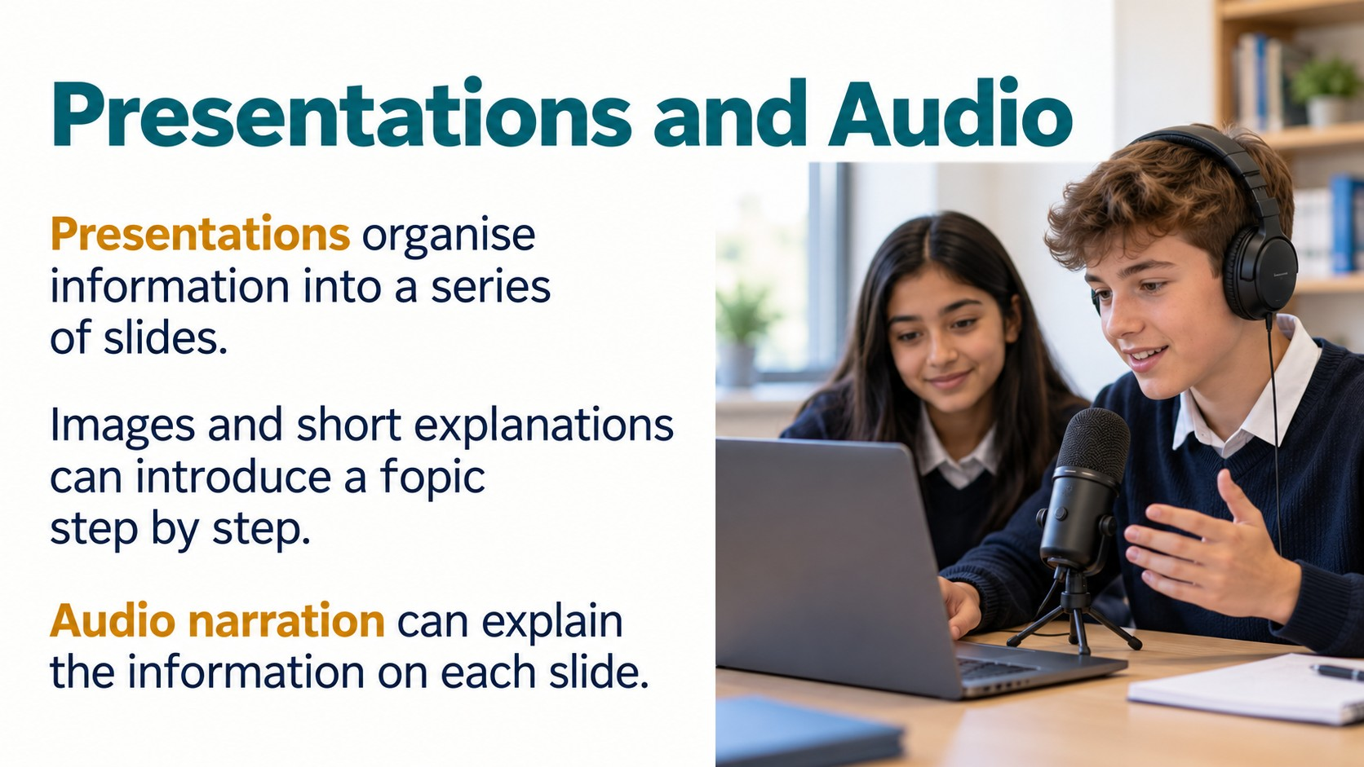
Notes:
Source: Oxford International Lower Secondary Computing Student Book 8, Unit 2, section 2.3 What is e-learning, printed pages 42–45, and section 2.4 Starting your e-learning project, printed pages 46–49. Classroom adaptation of approved content. Generated visuals are illustrative examples. Presentation software controls may vary by version.

Slide 10

Notes:
Source: Oxford International Lower Secondary Computing Student Book 8, Unit 2, section 2.3 What is e-learning, printed pages 42–45, and section 2.4 Starting your e-learning project, printed pages 46–49. Classroom adaptation of approved content. Generated visuals are illustrative examples. Presentation software controls may vary by version.

Slide 11
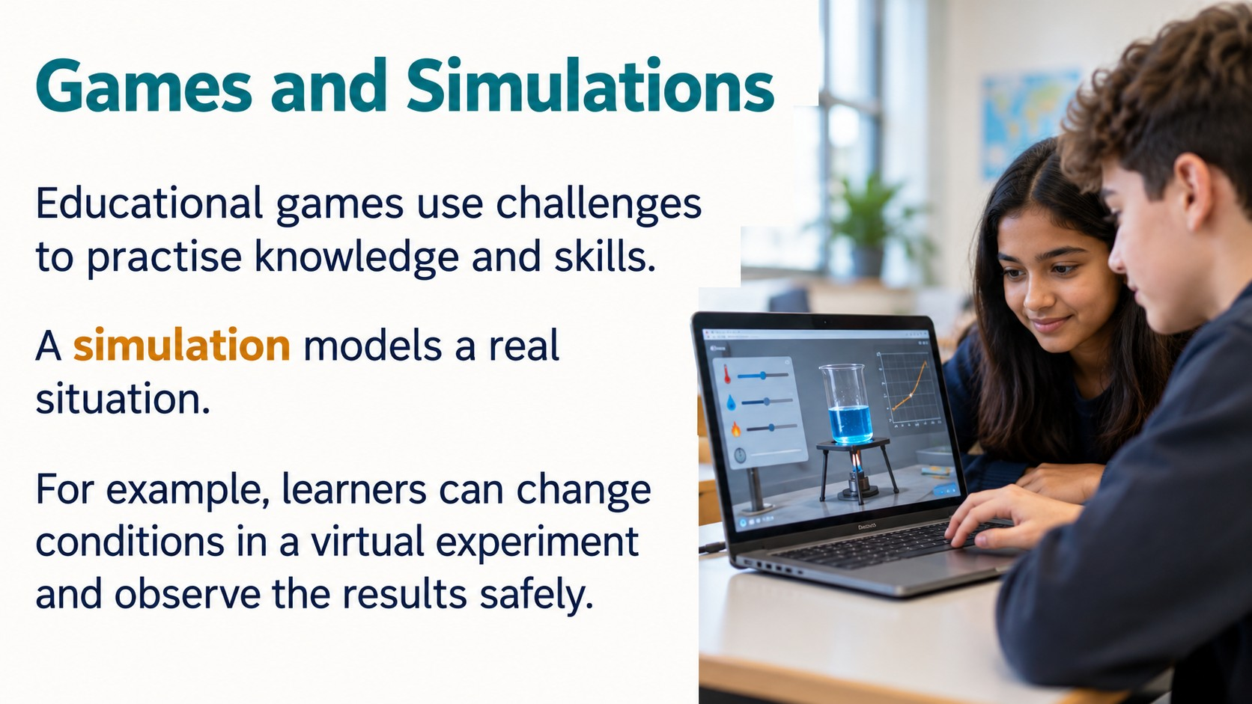
Notes:
Source: Oxford International Lower Secondary Computing Student Book 8, Unit 2, section 2.3 What is e-learning, printed pages 42–45, and section 2.4 Starting your e-learning project, printed pages 46–49. Classroom adaptation of approved content. Generated visuals are illustrative examples. Presentation software controls may vary by version.

Slide 12
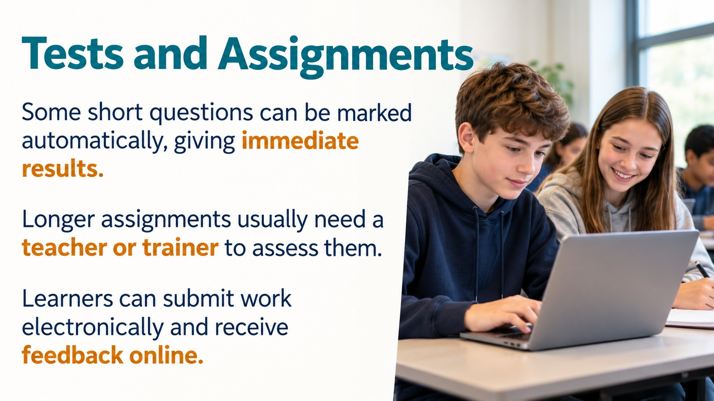
Notes:
Source: Oxford International Lower Secondary Computing Student Book 8, Unit 2, section 2.3 What is e-learning, printed pages 42–45, and section 2.4 Starting your e-learning project, printed pages 46–49. Classroom adaptation of approved content. Generated visuals are illustrative examples. Presentation software controls may vary by version.

Slide 13

Notes:
Source: Oxford International Lower Secondary Computing Student Book 8, Unit 2, section 2.3 What is e-learning, printed pages 42–45, and section 2.4 Starting your e-learning project, printed pages 46–49. Classroom adaptation of approved content. Generated visuals are illustrative examples. Presentation software controls may vary by version.

Slide 14
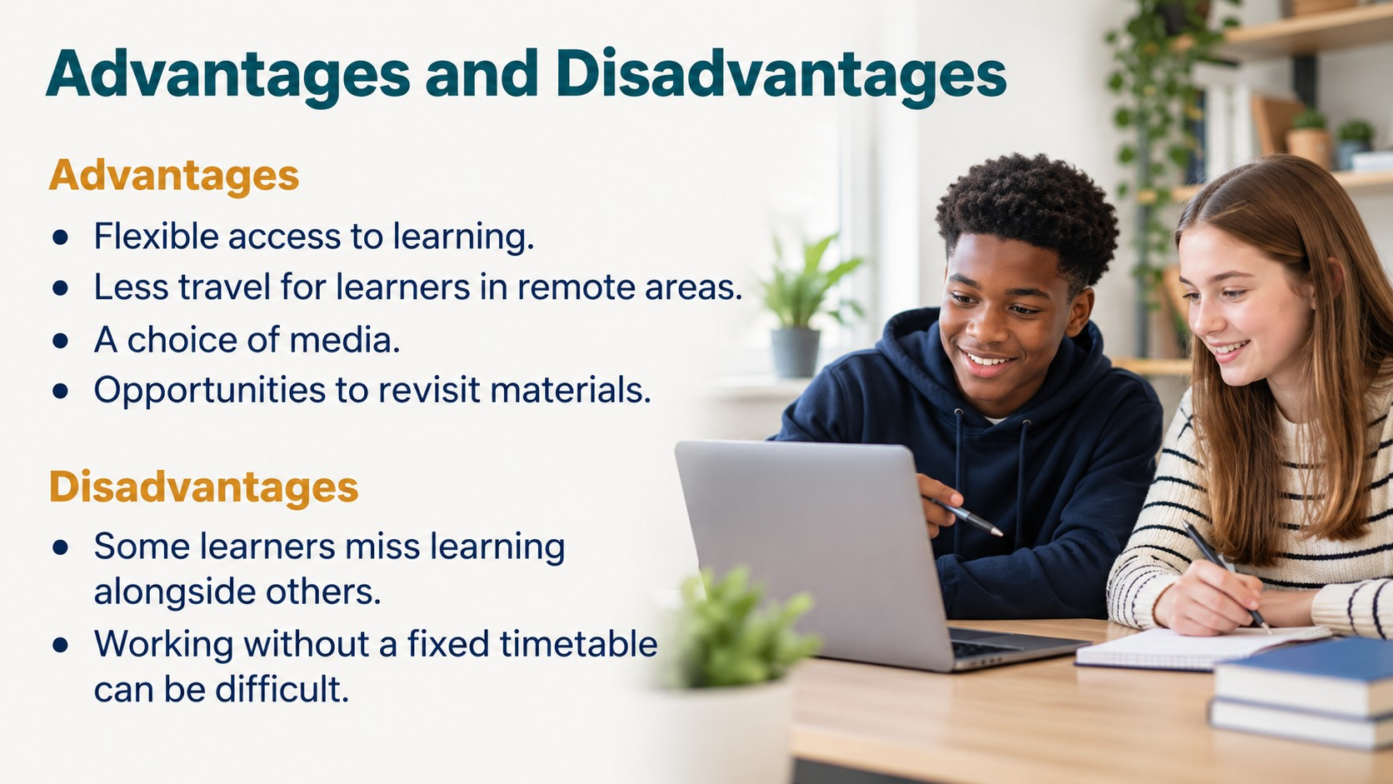
Notes:
Source: Oxford International Lower Secondary Computing Student Book 8, Unit 2, section 2.3 What is e-learning, printed pages 42–45, and section 2.4 Starting your e-learning project, printed pages 46–49. Classroom adaptation of approved content. Generated visuals are illustrative examples. Presentation software controls may vary by version.

Slide 15
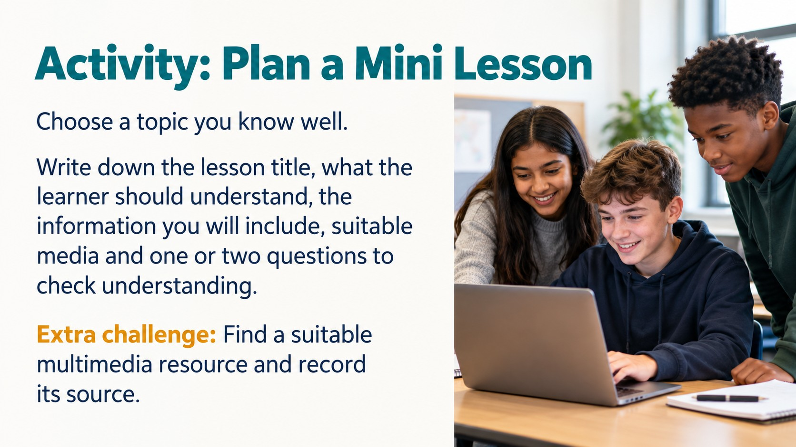
Notes:
Source: Oxford International Lower Secondary Computing Student Book 8, Unit 2, section 2.3 What is e-learning, printed pages 42–45, and section 2.4 Starting your e-learning project, printed pages 46–49. Classroom adaptation of approved content. Generated visuals are illustrative examples. Presentation software controls may vary by version.

Slide 16
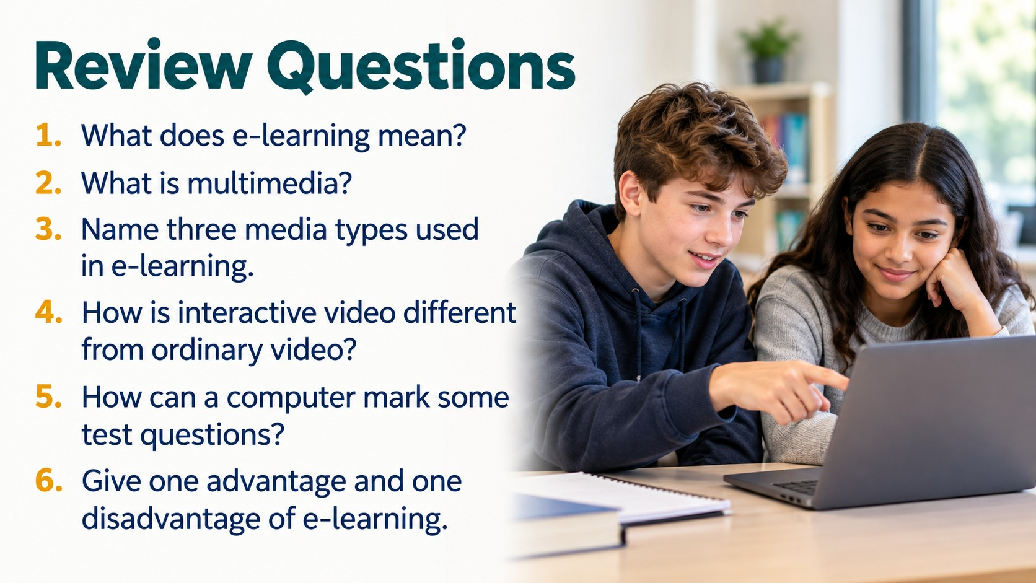
Notes:
Source: Oxford International Lower Secondary Computing Student Book 8, Unit 2, section 2.3 What is e-learning, printed pages 42–45, and section 2.4 Starting your e-learning project, printed pages 46–49. Classroom adaptation of approved content. Generated visuals are illustrative examples. Presentation software controls may vary by version.

